Slide 1
Introduction
Energy, Chemical and Food Equipment Segment in CIMC
Website: http://www.enricgroup.com
Tel:（+86）-755-26691130
Add： CIMC R&D Center,No.2 Gangwan Avenue,Shekou Industrial Zone.Shenzhen,GuangDong,P.R.C （518067）

Slide 2
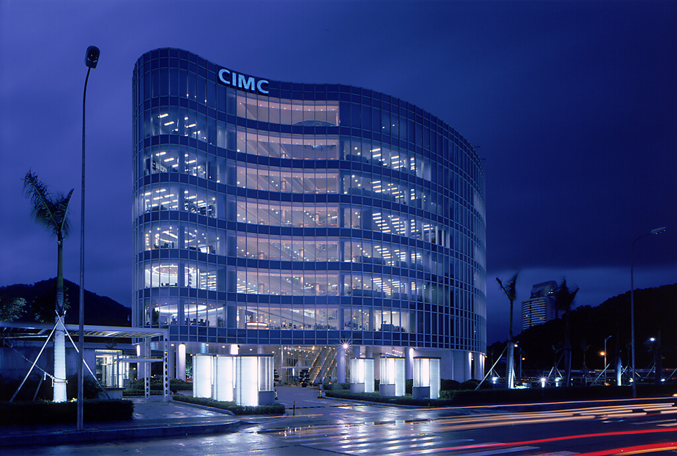
CIMC Group Profile
China International Marine Containers (Group) Ltd. (CIMC), the world leading supplier of logistics and energy equipment, headquartered in Shenzhen of China, is dedicated to supplying high-quality and reliable equipment and services, including containers, vehicles, energy, chemical and food equipment, offshore equipment, logistics service, airport facilities, etc.. As a diversified multinational operation group that shoulders the mission of global serving, CIMC has over 300 member enterprises and 3 listed companies in Asia, North America, Europe and Australia, and an extensive sales network that covers more than 100 countries and regions. In 2022, CIMC has witnessed inspiring sales proceeds of 186 billion RMB contributed by its 60,000 excellent staffs.
Offshore
Energy, Chemical and Food Equipment
Airport Facilities
8 Business Segments in CIMC
Container
Vehicles
Logistics
Finance
Real Estate

Slide 3
Introduction to Segment
——Energy, Chemical and Food Equipment Segment in CIMC
FORTUNE
Chinese version
Along with CIMC ENRIC Holding LTD., a Hong Kong main board listed company (stock code: 3899. HK) and one of Fortune Top 500 Chinese Enterprises, as the leading company, CIMC Energy Section, Chemical and Food Equipment Sector keeps a foothold in the energy industry, chemical industry and food equipment, providing customers with key equipment, engineering services and system solutions for transportation, storage and processing, and creating the "CIMC ENRIC" business brands. Now it has owned 12 brands.2022 operating income RMB 23 billion.
With 22 manufacturing bases and Research & Development Centers in China, Germany, Netherlands, Denmark, Belgium and other countries, the industry pattern of interaction and mutual support between China and Europe has come into being. Its marketing network has spread across North America, Europe, South America including Peru,Central Asia, Southeast Asia, Russia, Australia, China, Thailand, India and other regions and countries.
China Top 500 companies
Listed in Hongkong
Stock price increase TOP 10
2013年度港股涨幅10强

Slide 4
Natural Gas Value Chain
CIMC 丨 Enric Gas Equipment 丨 www.cimc-enric.com
LNG Regasification Station
Completely COVER
Natural Gas Industry
VALUE Chain
LNG Ship
LNG Railway Transportation by LNG Container
LNG Road Transportation by LNG Container
GAS Pre-treatment
LNG Liquefaction Plant
LPG Semi-trailer
LNG Export Terminal
LNG Semi-trailer
LPG Storage and Distribution
LNG Satellite Terminal
LPG Semi-trailer
LNG Marine Transportation by LNG Container
LNG Receiving Terminal
LNG Semi-trailer
GAS STORAGE & TRANSPORTATION
CNG Tube Trailer
CNG Storage Skid
LNG Semi-trailer/Tanker
LNG Storage Tank
CNG/LNG Plant
CNG/LNG Fueling Station
CNG/LNG Truck
LPG Semi-trailer/Tanker
LPG Storage Tank
Industrial Gas Equipment
LNG Regasification Station
LNG Regasification Station with Multiple LNG Storage Tanks
LPG Refueling Station
CNG Mother Station (Compression Station)
PRMS
L-CNG Refueling Station
CNG Tube Trailer
CNG Daughter Station
LNG Fuel Tank

Slide 5
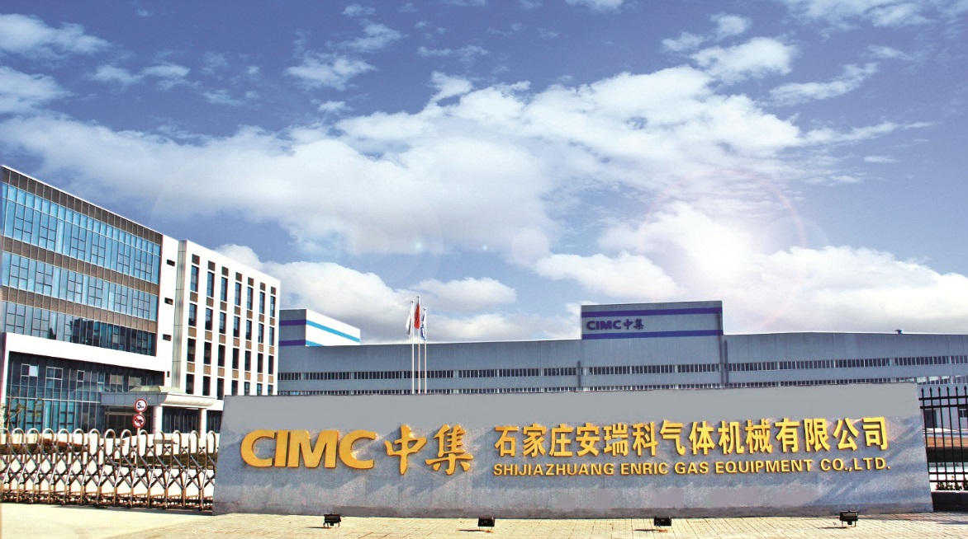
WHO WE ARE
CIMC 丨 Enric Gas Equipment 丨 www.cimc-enric.com
We, Shijiazhuang Enric Gas Equipment Co., Ltd.
is the key enterprise of CIMC Enric Holding Ltd.
With 40 years’ professional experience of pressure vessels, we are specialized in designing, manufacturing and providing a complete solution of the non-pipeline natural gas storage and transportation equipment. Until now, our equipment are serving for over 1000 clients worldwide, enjoying high reputation.

Slide 6
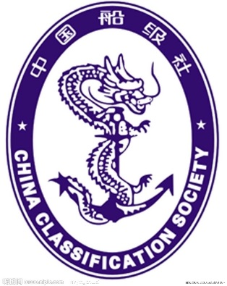
WHO WE ARE
CIMC 丨 Enric Gas Equipment 丨 www.cimc-enric.com
INTERNATIONAL CERTIFICATES
01 ISO 9001:2000
02 ISO 14001:2004
03 ISO 18001:2007
04 ISO 11120 Factory Approval Certificate
05 TPED (B) Certificate for tube as per ISO11120
06 Certificate of Factory Approval by BV
07 DOT 3AA, 3AAX, 3T certificate for high pressure tubes
08 ASME U & U2 T for pressure vessels
09 National Board registration for pressure vessels
10 SAE J2343 test approval for LNG vehicle tank
11 Canadian Registration Number for LNG storage tank
12 TC(Transport Canada) 3AAXM & 3TM Certificate
13 Tube Container (MEGCs) Certificate by ABS
14 KGS(Korea Gas Safety Corporation) Certificate
15 Certificate of Approval For Portable Tank by CCS
16 Russia TP TC Certificate

Slide 7
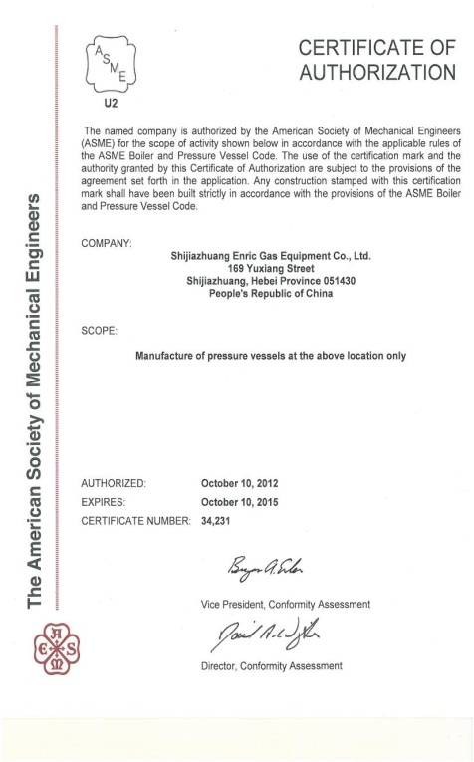
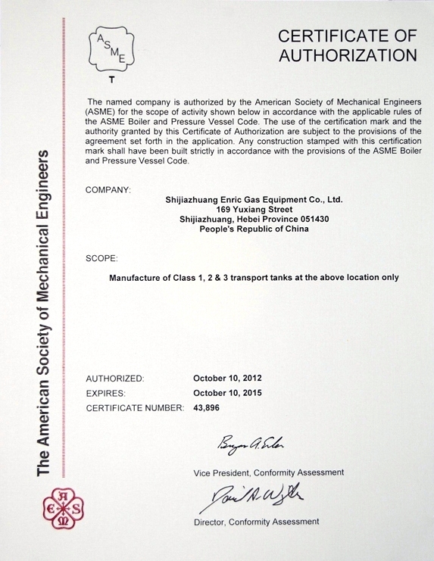
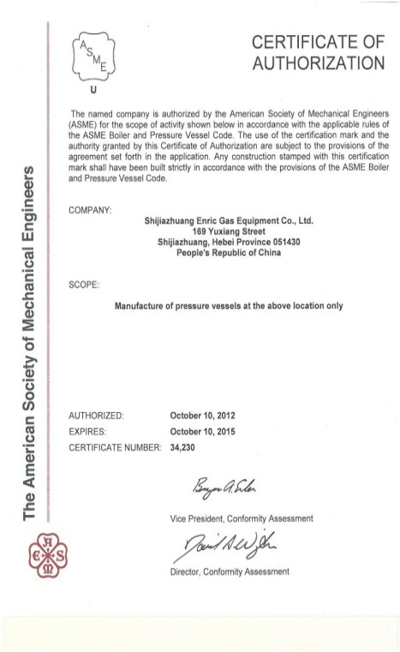
WHO WE ARE
CIMC 丨 Enric Gas Equipment 丨 www.cimc-enric.com
INTERNATIONAL CERTIFICATES
ASME U、U2、T CERTIFICATE

Slide 8
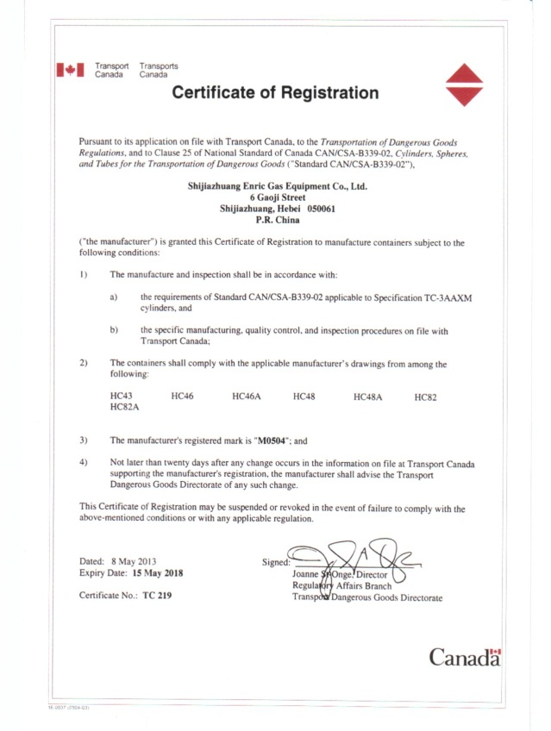
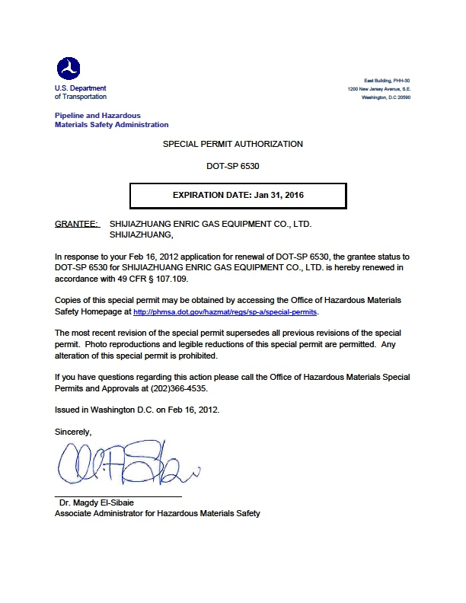
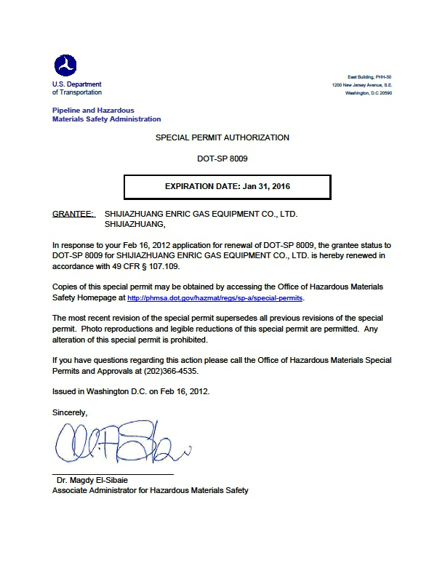
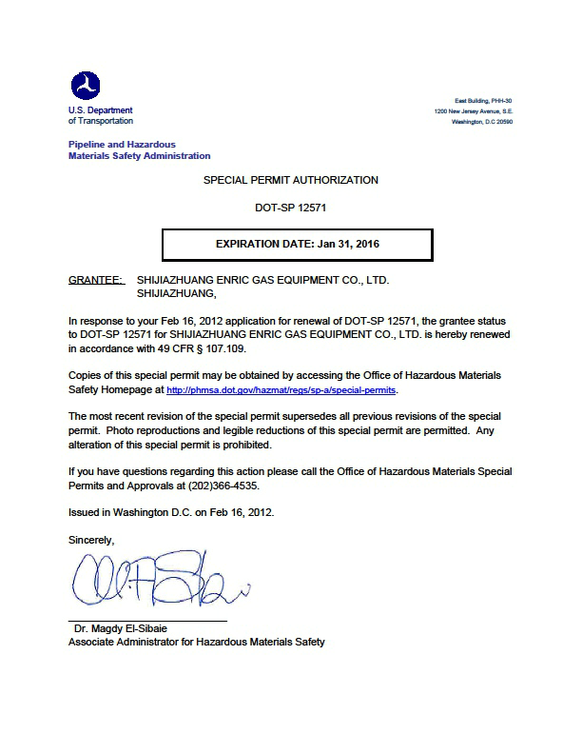
WHO WE ARE
CIMC 丨 Enric Gas Equipment 丨 www.cimc-enric.com
INTERNATIONAL CERTIFICATES
Canada TC Certificate
DOT-SP 8009、12571、6530 Special Permit Authorization

Slide 9
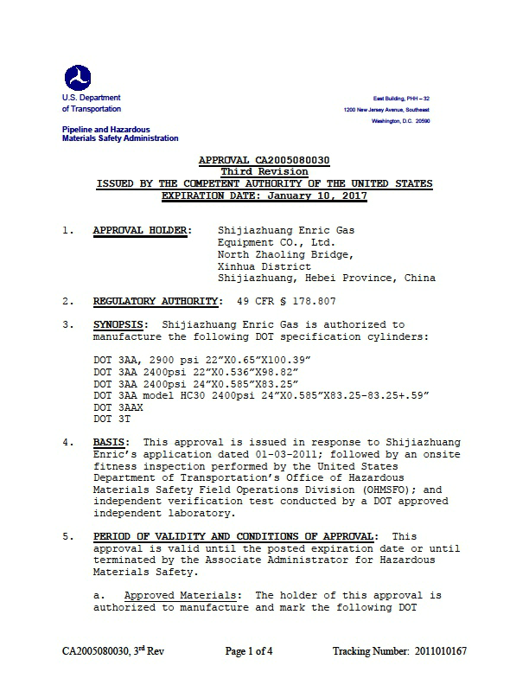
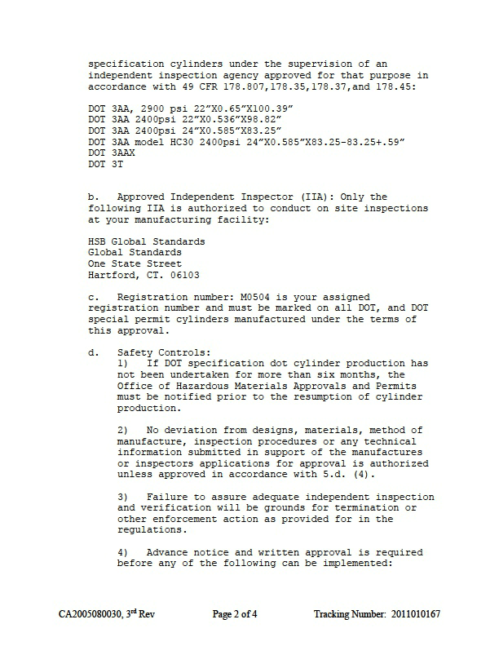
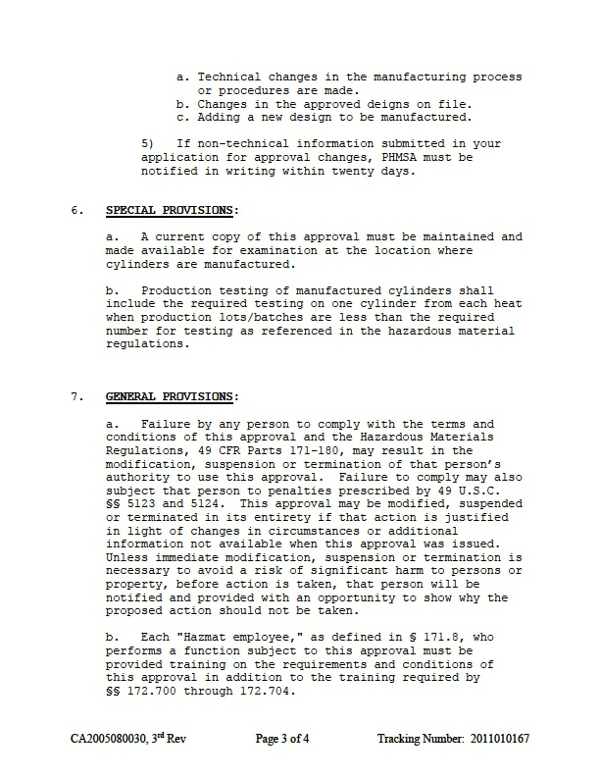
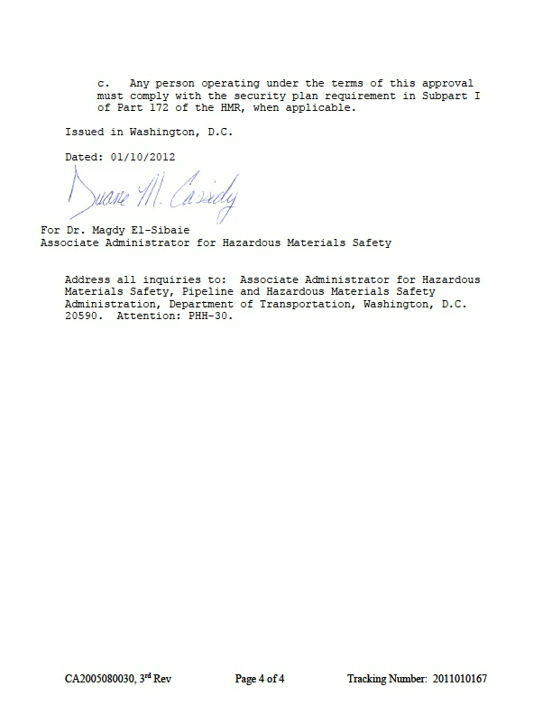
WHO WE ARE
CIMC 丨 Enric Gas Equipment 丨 www.cimc-enric.com
INTERNATIONAL CERTIFICATES
DOT-3T 、3AA、3AAX Seamless Steel Cylinder Manufacture Certificate

Slide 10
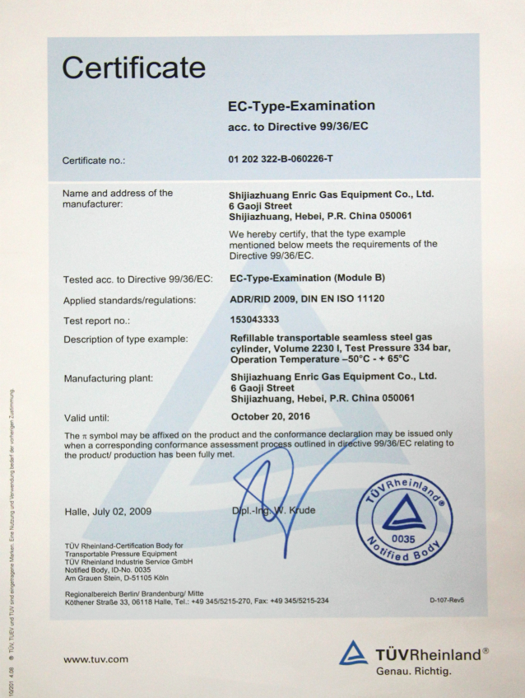
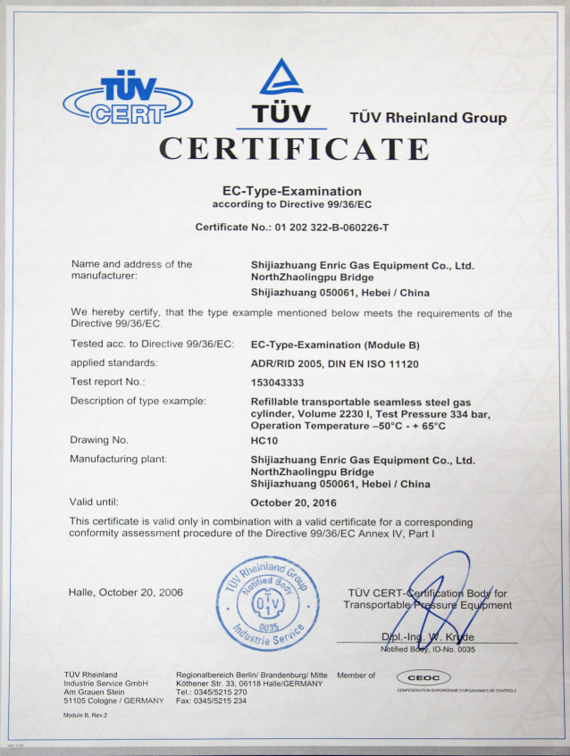
WHO WE ARE
CIMC 丨 Enric Gas Equipment 丨 www.cimc-enric.com
INTERNATIONAL CERTIFICATES
TUV Rheinland Group ISO11120 TPED Certificate

Slide 11
Key Equipment Manufacturing
Tanks•Trucks•Cylinders•Stations
We provide core storage, transportation and core processing equipment for energy, chemical and food industries. We hold design and manufacturing licenses for A1, A2, A3, C2 and C3, as well as SAD pressure-vessel-analysis design license, ASME "U", "U2" and "T" authorized seals and DOT, the EU PED, TPED, CE certificates and has passed certification from the British LR, the French BV, CCS China and our s products comply with ISO and ASME, GB and other international and domestic standards and norms.
We can provide high quality standardized or customized equipment for global customers, and also deliver high quality after-sales service anytime and anywhere. And we are committed to creating the mainstream products with global competitiveness.

Slide 12
Key Equipment
Manufacturing
Business Recommend
Refrigerated Liquid Storage Tanks
The tank is used for storage of refrigerated liquid LO2, LN2, LAr, LH2, LHe, LNe, etc. The unique internal insulation structure design combined with advanced vacuum technology ensures persistent vacuum lift of the tank; by applying innovative modular piping system and piping structure design, the static rate of evaporation of tank, can be guaranteed better than the industry standard.
Tank Container
Main products:：standard liquid tank containers, special liquid tank containers, liquefied gas tank containers, refrigerated liquid tank containers and powder tank containers.
Stainless Steel Food Storage Tank
Main products:juice tank, fermentation tank, wine tank, dairy product & liquid food tank, etc.
High Pressure Gas Collection Tube Bundles The products conform to the requirements of the ISO668 international container standard size and have passed authentication of DOT, KGS, TC, ABS, BV, TPED; the invention patent CNG - type 2 wrapped cylinder are used to make possible the lightweight and larger geometry volume. The products are mainly used in aerospace, nuclear power, electronics, etc., and have been exported to the United States, Indonesia, Thailand and other countries and regions.
With the world-leading T50 gas tank container, we have created another world-class champion product again, in addition to supplying high quality T75 refrigerated liquid tank containers and powder tank containers.By using containerized and standardized storage and transportation tanks, we provide customers with modern transportation solutions for liquid, gas, powder, etc.
Since 1947, Holvrieka has been committed to the R&D,design, manufacturing and installation
of static stainless steel tanks for food storage, and its products are widely used in beer, juice, Food and dairy industries. Advanced
processing equipment and reasonable global layout of
production bases make Holvrieka stainless steel Food storage industry pioneer leading the development of the brand.

Slide 13
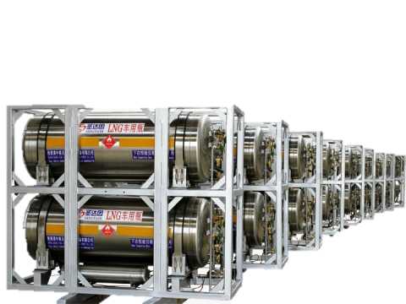
Key Equipment
Manufacturing
Business Recommend
Refrigerated Liquid Transport Semi-trailer
Main products:：liquefied natural gas (LNG) trucks, liquid carbon dioxide trucks, liquid oxygen trucks, liquid nitrogen trucks and liquid argon transport trucks.
Refrigerated Insulation Gas Cylinder
Main products:LNG welding insulation gas cylinder, automotive LNG cylinders, gas welding insulation gas cylinder.
High Pressure Long Tube Trailer
Main products: compressed natural gas transport semi-trailer, compressed gas transport semi-trailer, etc.
The Company has owned multiple patents and certificates for key new products, and has compiled the national standards of related products.
The products are used for transportation and storage of special gases, such as compressed natural gas (CNG), hydrogen, helium, nitrogen, argon, compressed air, etc..With after-sales testing and service network all over the country, The Company has the capability to quickly and efficiently provide professional services for its customers.
The products are used in the field of storage and transport of liquefied natural gas (LNG), liquid oxygen, liquid nitrogen, liquid argon, and liquid carbon dioxide.The Company can obtain different qualification certificates according to users’ requirements and has the ability to meet the demand for both the domestic and overseas market.
Gas Booster Compressor Main products:：standardized, modularized, serialized, skid-mounted, intelligent and miniaturized equipment..
Liquefied Gas Transport Semi-trailer
Main products: LPG transport semi-trailer, liquefied gas transport semi-trailer, liquid ammonia transport semi-trailer, chemical liquid transport semi-trailer,etc.
We have a number of patents and certificates for key new products, and have compiled the national standard of related products.The products are
Used for transportation of liquefied gas, liquid ammonia, chemical liquid, such as liquefied petroleum gas, liquid ammonia, natural gas, propylene oxide, etc.

Slide 14
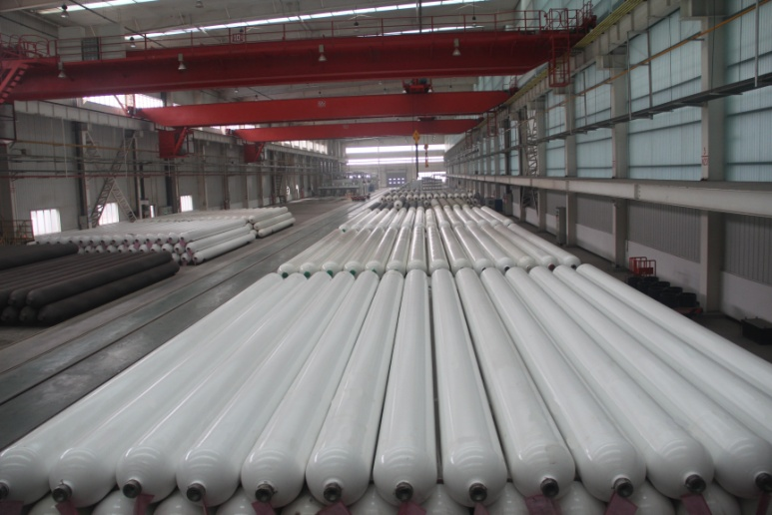
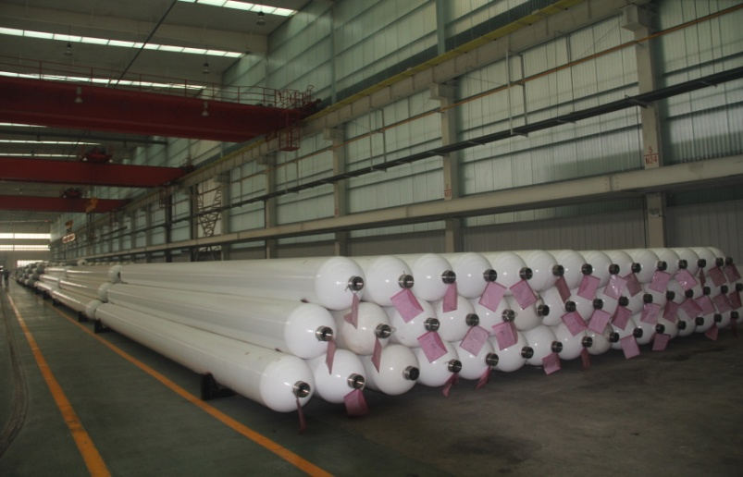
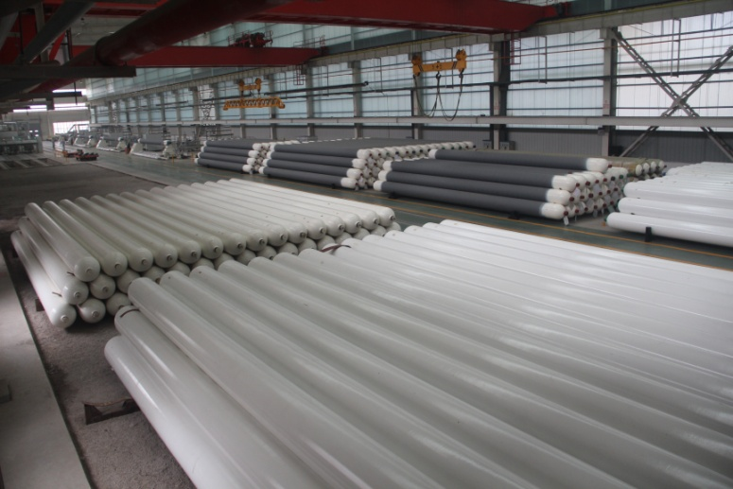
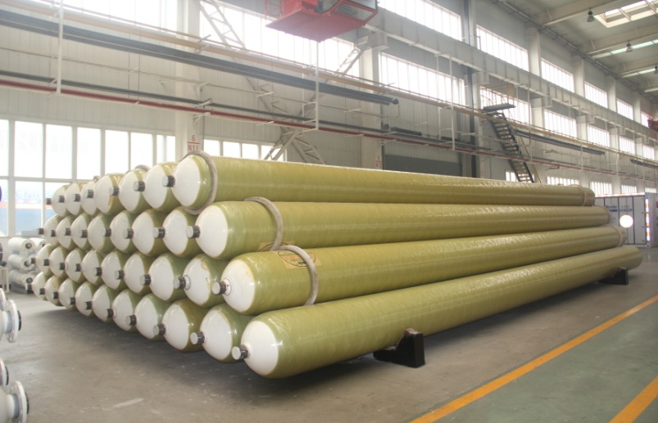
WHAT WE DO
CIMC 丨 Enric Gas Equipment 丨 www.cimc-enric.com
High Pressure Hydrogen and CNG Product
High Pressure Hydrogen and CNG Cylinder

Slide 15
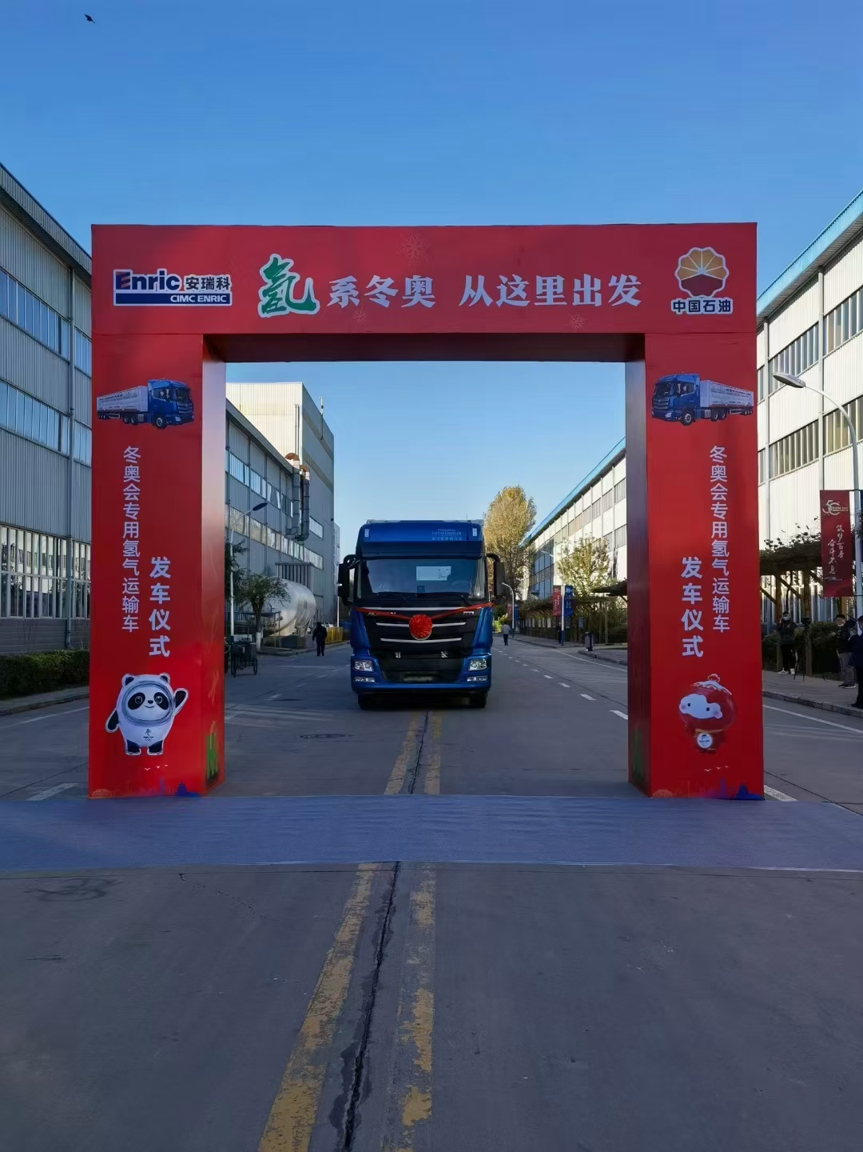
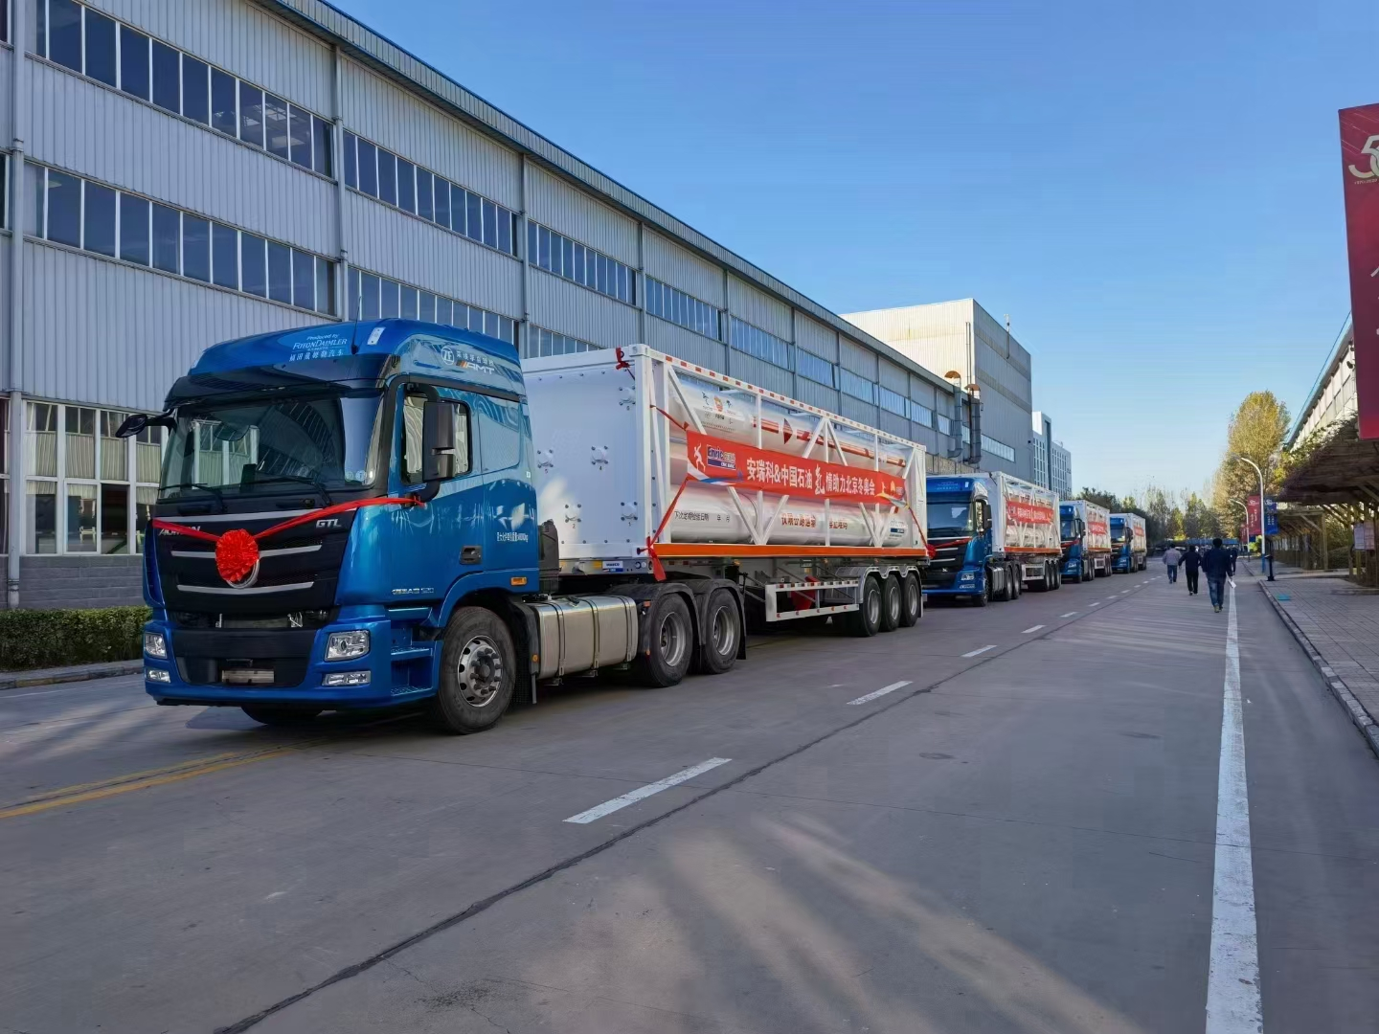
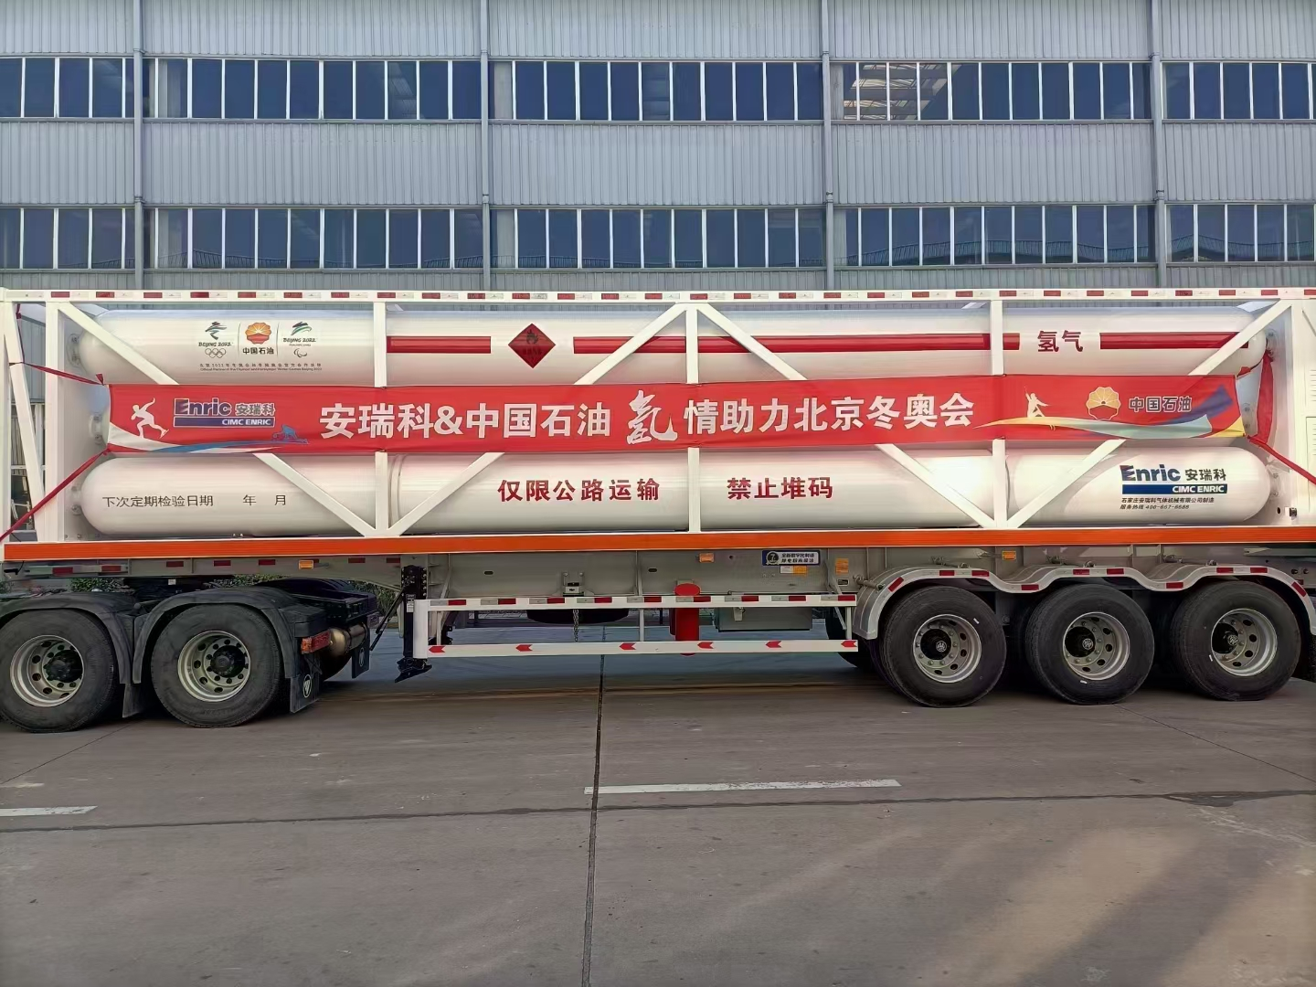
WHAT WE DO
CIMC 丨 Enric Gas Equipment 丨 www.cimc-enric.com
Hydrogen High Pressure Product
H2 Tube Trailer

Slide 16
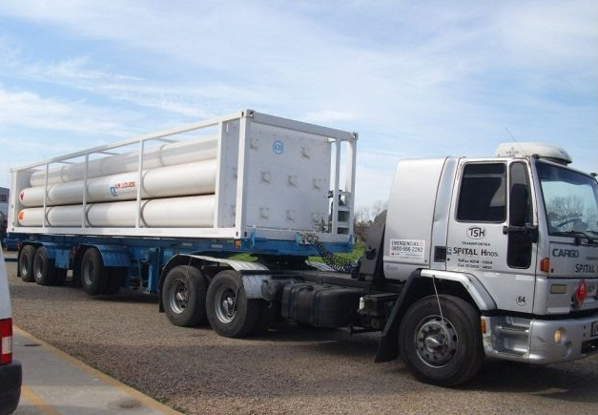
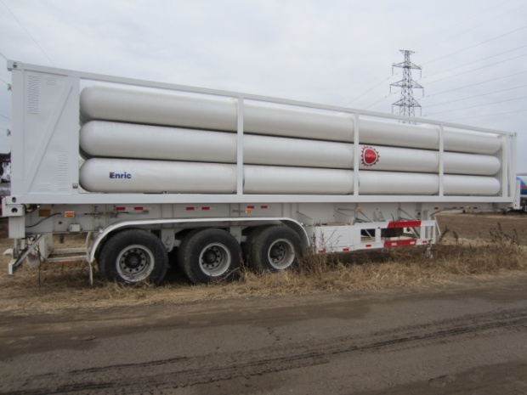
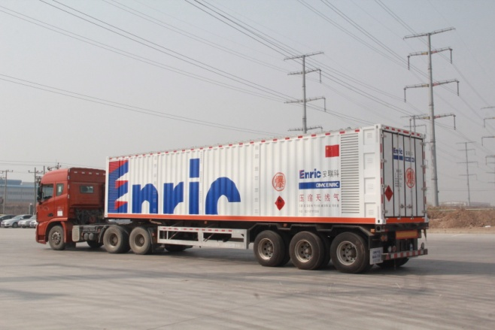
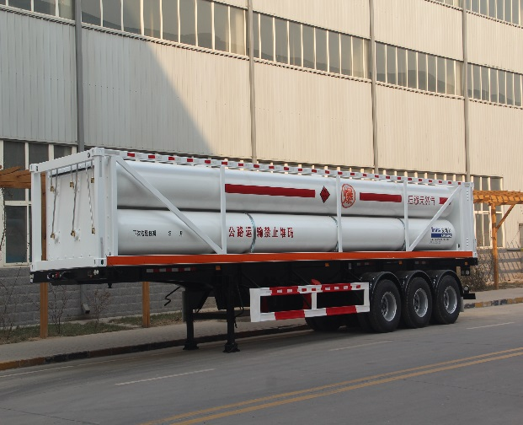
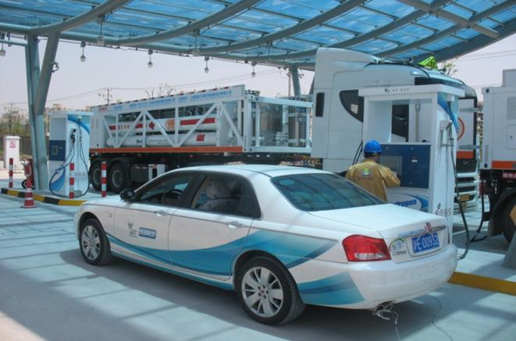
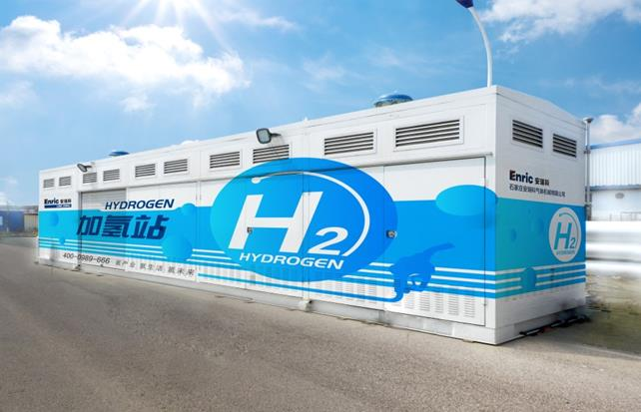
WHAT WE DO
CIMC 丨 Enric Gas Equipment 丨 www.cimc-enric.com
High Pressure Product
Hydrogen and CNG Tube Trailer
ISO11120 | ISO11120 | ISO11515 | DOT-3AAX
40ft | 40ft | 40ft | 20ft
250bar | 250bar | 250bar | 250bar
10 cylinders | 12 cylinders | 12 cylinders | 9 cylinders
∅559x17.3x11580mm | ∅559x14.8x10975mm | ∅559x9.3/6.75x12190mm | ∅715x22.1x5400mm
23.7M³ | 27.6M³ | 32M³ | 15.48M³
7075NM³ | 8380NM³ | 9570NM³ | 4700NM³

Slide 17
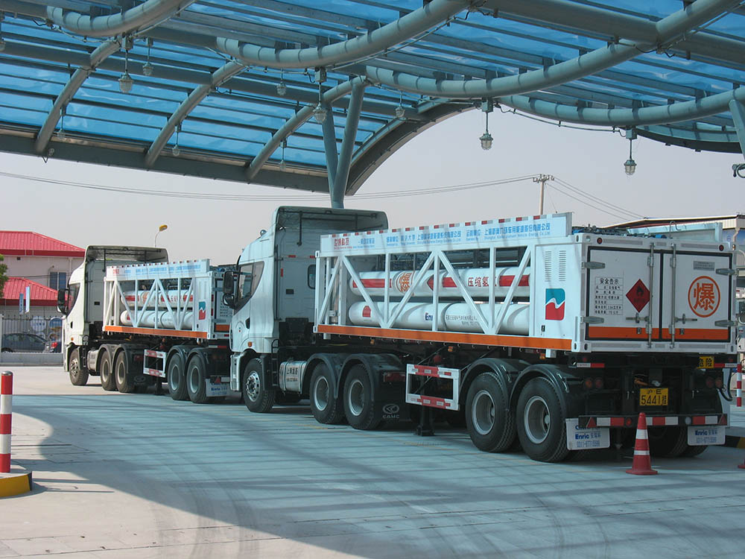
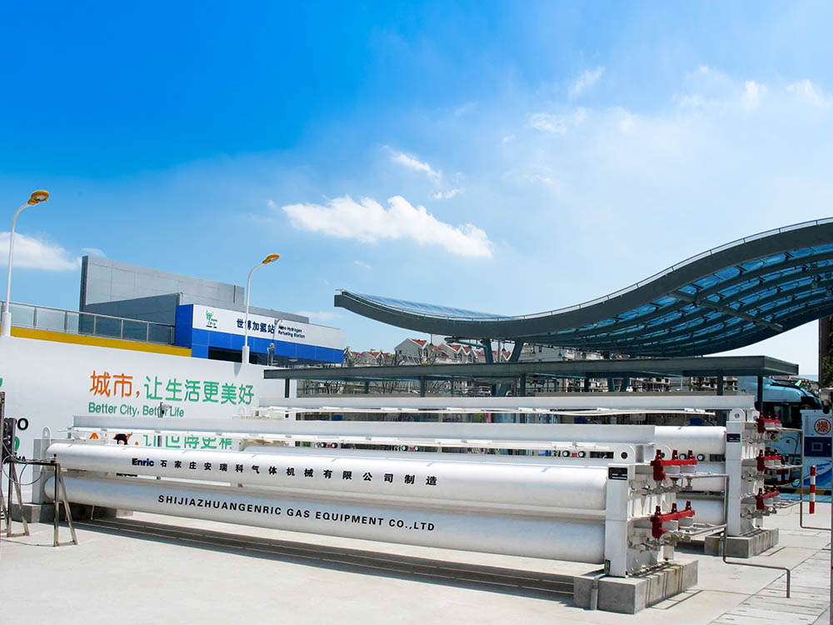
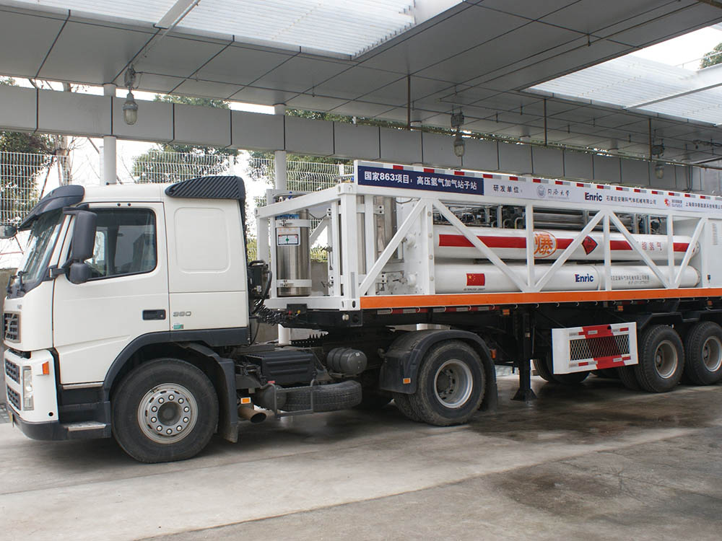
WHAT WE DO
CIMC 丨 Enric Gas Equipment 丨 www.cimc-enric.com
H2 Refueling Station

Slide 18
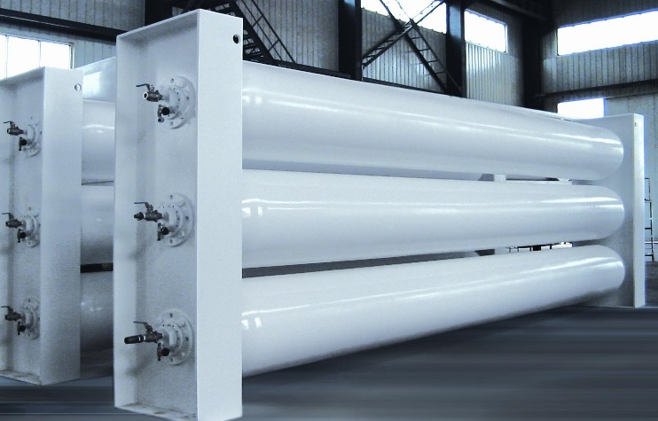
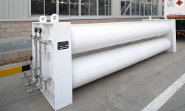
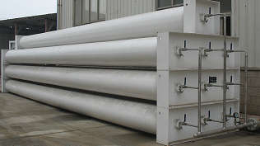
WHAT WE DO
CIMC 丨 Enric Gas Equipment 丨 www.cimc-enric.com
High Pressure Product
Hydrogen and CNG Storage Cascade
DESIGN PRESSURE (ASME STANDARD) | OUTSIDE DIAMETER |  | LENGTH |  | NOMINAL WATER VOLUME |  | WEIGHT/ UNIT
 | in | mm | ft | mm | Cubic ft | liters | lbs | kg
8000psi / 552bar | 16 | 406 | 29 | 8840 | 24 | 685 | 7412 | 3362
5500psi / 379bar | 20 | 508 | 23 | 7,010 | 34.3 | 972 | 6702 | 3042
 | 20 | 508 | 38 | 11,580 | 58 | 1642 | 11070 | 5020
4000psi / 276bar | 24 | 610 | 24 | 7,315 | 54.3 | 1536 | 7400 | 3357
2800psi / 193bar | 24 | 610 | 24 | 7,315 | 58.6 | 1674 | 6052 | 2745

Slide 19
WHAT WE DO
CIMC 丨 Enric Gas Equipment 丨 www.cimc-enric.com
Application
CNG Tube Trailer for transportation
CNG Refueling Station
Industrial Application
Power Plant
CNG Carrier
Tube Trailer/Skid of Compressed Industrial Gases
……

Slide 20
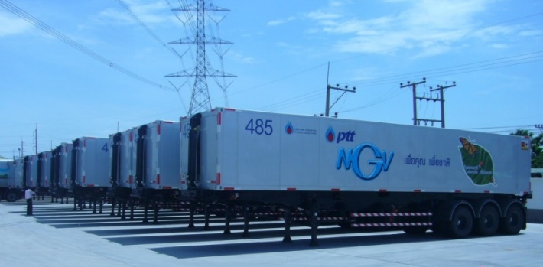
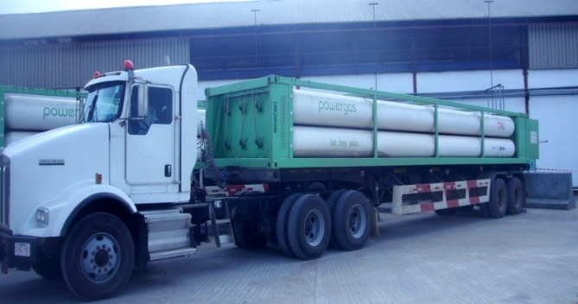
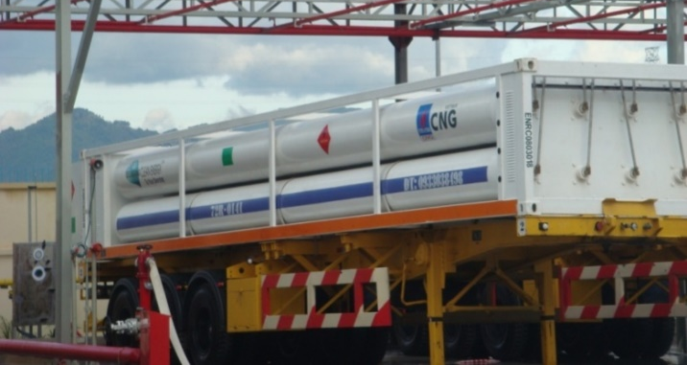
WHAT WE DO
CIMC 丨 Enric Gas Equipment 丨 www.cimc-enric.com
CNG Tube Trailer for transportation
Indonesia
Thailand
Nigeria
Vietnam

Slide 21
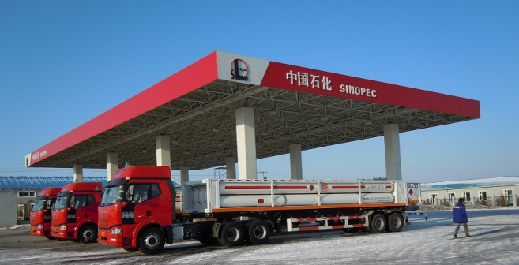
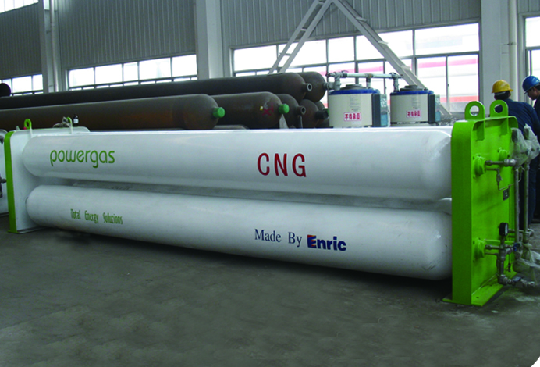
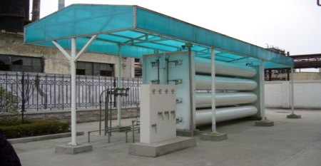
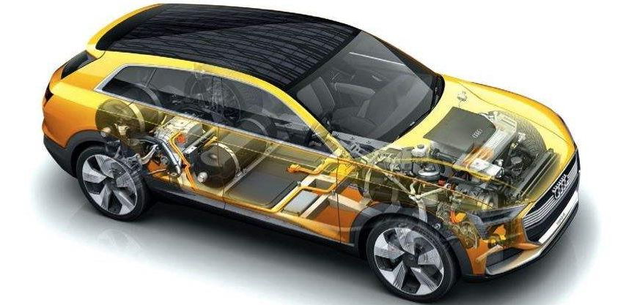
WHAT WE DO
CIMC 丨 Enric Gas Equipment 丨 www.cimc-enric.com
Hydrogen Refueling Station
Standard Hydrogen and CNG Refueling Station

Slide 22
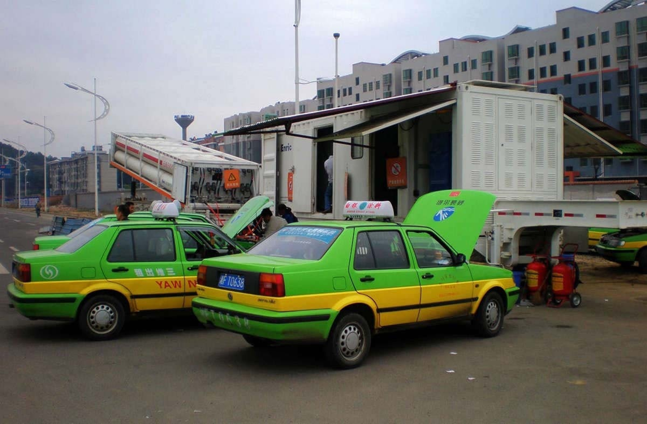
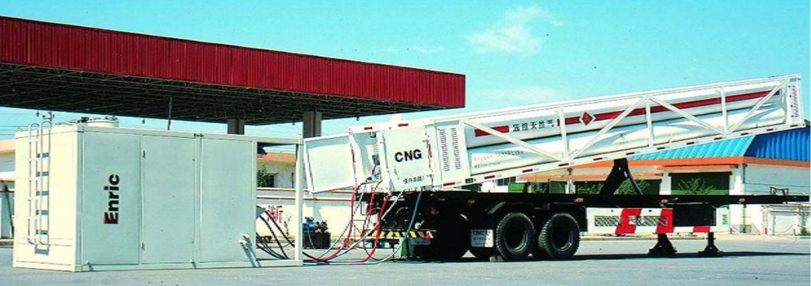
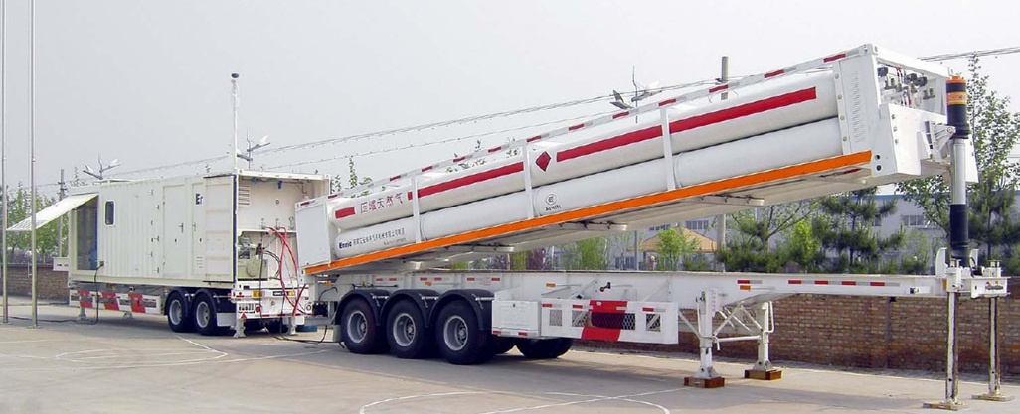
WHAT WE DO
CIMC 丨 Enric Gas Equipment 丨 www.cimc-enric.com
Hydrogen and CNG Refueling Station
Hydraulic Pressure Unit (HPU)

Slide 23
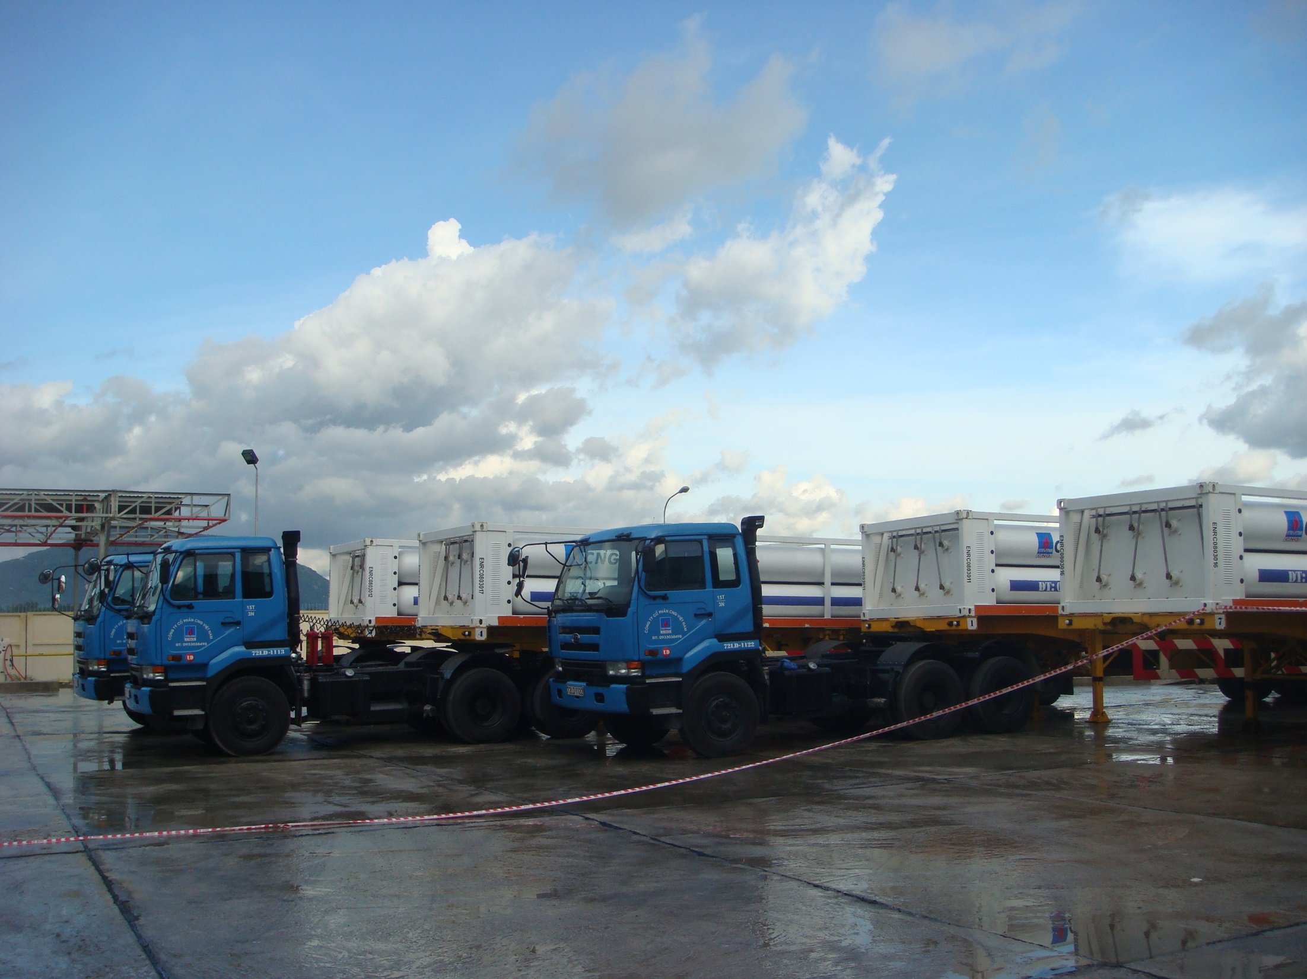
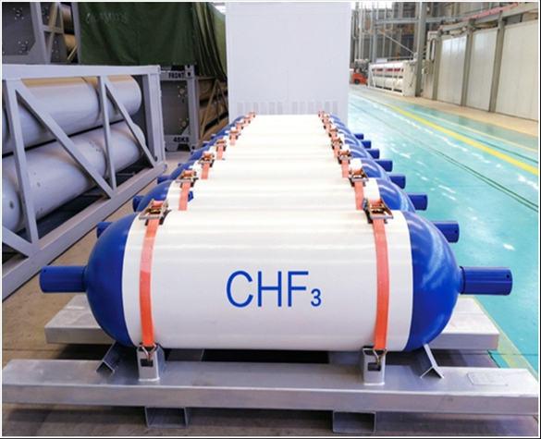
WHAT WE DO
CIMC 丨 Enric Gas Equipment 丨 www.cimc-enric.com
Industrial Application
Hydrogen and CNG Loading/Unloading and Transportation

Slide 24
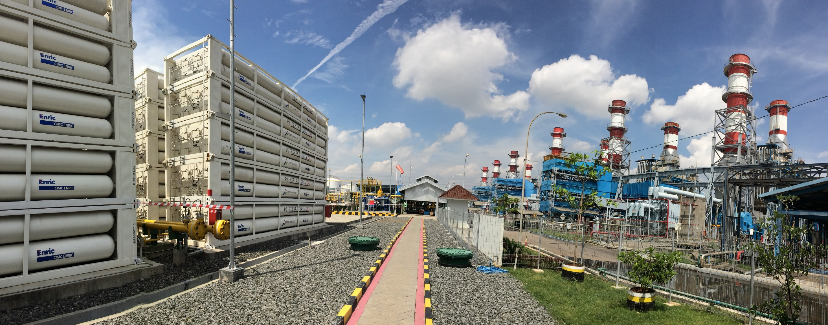
WHAT WE DO
CIMC 丨 Enric Gas Equipment 丨 www.cimc-enric.com
Power Plant
CNG Storage Cascades
Used for power plant in Indonesia

Slide 25
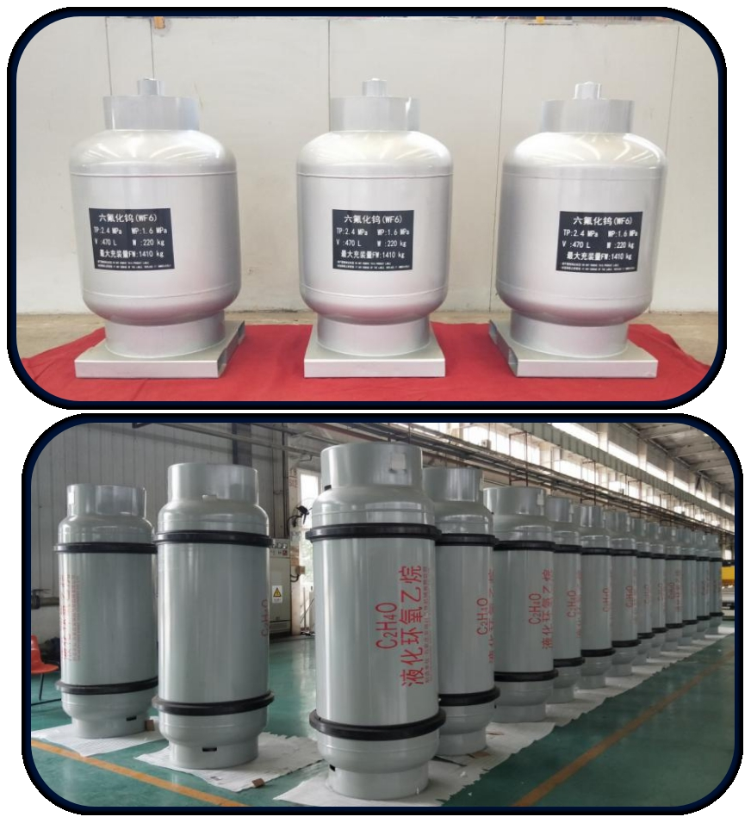
WHAT WE DO
CIMC 丨 Enric Gas Equipment 丨 www.cimc-enric.com
Power Plant
CNG Storage Cascades
Used for power plant in Indonesia

Slide 26
WHAT WE DO
CIMC 丨 Enric Gas Equipment 丨 www.cimc-enric.com
H2 and CNG Carrier
The World’s First CNG Carrier
Powered by Natural Gas (CNG)
Used for CNG transportation and gas supply from one island to another

Slide 27
Engineering Services
Overall Project Contract•Project Design•Project Supervision•Overall Design
According to the different needs of the owners, we can provide comprehensive customer services ranging from project feasibility analysis, project initiation, project survey, design, construction, package equipment manufacturing, installation, to commissioning. With reliable quality management system and sound project management system, and Class A Design Qualification Certificates, Class A general Contracting Qualification Certificate and Class A Engineering Consulting Certificate, The Company provides customers with customized EPC, E, EP, or EP + CS, PM and other forms of engineering services.

Slide 28
Engineering Services
Business Recommend
CNG、L-CNG、LNG/L-CNG Refueling Station
CIMC has mature experience in building LNG, L - CNG, LNG/L - CNG standard stations and skid-mounted stations, and can configure various kinds of oil and gas adding modes according to different size, different regions, different environmental and resource conditions of projects, and meet the diverse needs of customers.
The Company built Xinjiang Urumqi LPG stations, China's first domestic LNG refueling station and one of the biggest LNG stations-CNOOC LNG demonstration gas stations respectively in Shangchong of Shenzhen and Doumen of Zhuhai.
Technical Features
◆In the forms of skid-mounted station and fixed station, the gas station
features stable refueling, accurate measurement, low loss, and over 6000h trouble-free working hours. ◆ With skid-mounted structure, the equipment is simple and compact, with short construction period, low operation cost and investment and small floor area; it can be transported with trails and change location of refueling according to the market demand. ◆ Through PLC control, the station could be fully automated.
◆ Using the self-developed station control management system, it can be operated safely and reliably.

Slide 29
WHAT WE DO
CIMC 丨 Enric Gas Equipment 丨 www.cimc-enric.com
Cryogenic Product
LNG Storage Tank
Capacity: 30m³,50m³, 60m³, 100m³, 150m³, 227m³ , 1500m³ , 3500m³ , 5000m³ , 6000m³ etc.
Standard: GB, ASME
Working Pressure: 0.005- 2.5MPa
Design Temperature: -196℃
Insulation : High vacuum +Multi-layer insulation/Pearlite

Slide 30
WHAT WE DO
CIMC 丨 Enric Gas Equipment 丨 www.cimc-enric.com
LNG Container for Multi-modal Transportation

Slide 31
WHAT WE DO
CIMC 丨 Enric Gas Equipment 丨 www.cimc-enric.com
LNG Semi-Trailer

Slide 32
WHAT WE DO
CIMC 丨 Enric Gas Equipment 丨 www.cimc-enric.com
LNG Refueling Station
LNG thermal siphon storage tank
LNG Vehicle Tank
Mobile LNG refueling vehicle

Slide 33
WHAT WE DO
CIMC 丨 Enric Gas Equipment 丨 www.cimc-enric.com
LNG Refueling Station on water

Slide 34
Engineering Services
Business Recommend
LNG Receiving Terminal, Gasification Station of Large Storage Tanks
TGE has accomplished a number of large-capacity LNG tank projects, such as Calhoun NG terminals in the United
Based on the technology and management originated from TGE, an independent project general contractor with 25 years of experience, we are able to
States, Kitimat LNG receiving station in Canada and CNOOC Zhejiang Ningbo LNG Receiving Terminal, etc., which have become the model of LNG industry.
Manufacturing capacity of large LNG storage tanks：5000-160000m³。
provide overall solutions of LNG receiving terminal and turnkey projects, including EPC general contracting project and FEED service for LNG receiving terminal.

Slide 35
MARKET
CIMC 丨 Enric Gas Equipment 丨 www.cimc-enric.com
www.cimc-ege.com
United Kingdom
Kazakhstan
Shijiazhuang
Canada
USA
Egypt
Thailand
Nigeria
Kenya
Vietnam
Taiwan
Burma
Philippines
Malaysia
Singapore
Colombia
Indonesia
Peru
Brazil
Argentina
Headquarter
Sub-company
Business office
Main market

Slide 36
Introduction to Segment
Cooperative Partners
Chemical Industries
Energy Industries
Food Industries

